Slide 1


Hotel Reservation Analysis
By,
Keerthi Priya R

Slide 2
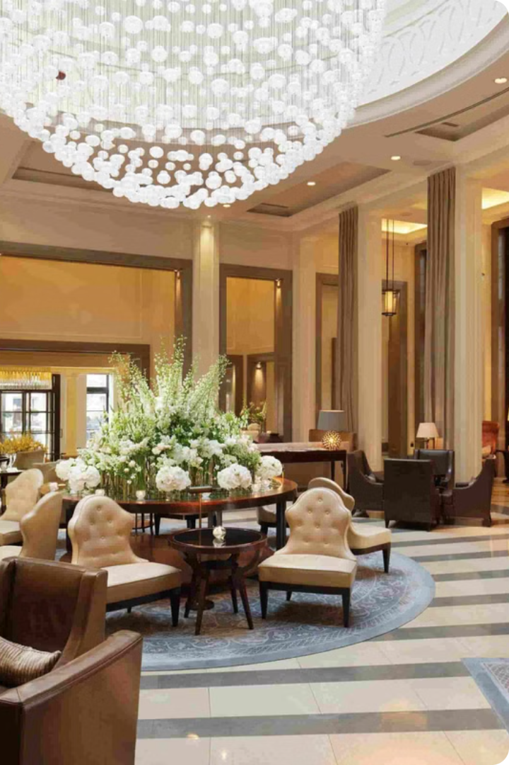
Introduction to Hotel Reservation Analysis
This project explores how hotels can leverage data to enhance the guest experience and optimize their operations. By analyzing hotel reservation data, we'll uncover valuable insights to improve occupancy rates, pricing strategies, and overall guest satisfaction.

Slide 3

Data Exploration and Understanding
1
Understand Data Structure
2
Identify Key Variables
Pinpoint the most important factors that influence hotel reservations, such as room type, booking date.
Examine the schema of the hotel reservation dataset, including tables, fields, and relationships.
3
Detect Data Quality Issues
Assess the completeness, accuracy, and consistency of the data to ensure reliable analysis.

Slide 4

Dataset Details:
The dataset includes the following columns:
Booking_ID : A unique identifier for each hotel reservation.
no_of_adults: The number of adults in the reservation.
no_of_children: The number of children in the reservation.
no_of_weekend_nights: The number of nights in the reservation that fall on weekends.
no_of_week_nights: The number of nights in the reservation that fall on weekdays.
type_of_meal_plan: The meal plan chosen by the guests.
room_type_reserved: The type of room reserved by the guests.
lead_time: The number of days between booking and arrival.
arrival_date: The date of arrival.
market_segment_type: The market segment to which the reservation belongs.
avg_price_per_room: The average price per room in the reservation.
booking_status: The status of the booking.
Notes:
The goal of this analysis is to gain insights into guest preferences for different room types, amenities, and their price sensitivity. We'll start by examining the popularity of various room types and how they correlate with guest demographics and booking patterns. Next, we'll identify the most valued amenities that guests seek when booking their stay, such as gym access, spa services, or high-speed internet. Finally, we'll analyze how guests respond to changes in room rates and which factors influence their willingness to pay. The dataset we'll be using includes details on each hotel reservation, such as the number of adults and children, the type of meal plan, the room type reserved, the lead time, arrival date, market segment, average price, and booking status. This information will allow us to uncover important insights about guest preferences and behavior. • Seasonal booking patterns are crucial for understanding demand fluctuations throughout the year. • Identifying peak and off-peak periods allows us to better anticipate occupancy and optimize pricing and inventory. • Analyzing lead time data gives insights into how far in advance guests typically book. This can inform marketing and sales strategies. • Examining cancellation rates helps us identify potential causes and develop ways to minimize no-shows, which impact revenue. • Understanding these booking trends empowers us to make more informed decisions and improve the overall guest experience.

Slide 5

Analyse dataset using SQL
Tasked with analysing this hotel reservation dataset using SQL.
Here are 15 questions, to write SQL queries to gain insights:
What is the total number of reservations in the dataset?
Which meal plan is the most popular among guests?
What is the average price per room for reservations involving children?
How many reservations were made for the year 20XX (replace XX with the desired year)?
What is the most commonly booked room type?
How many reservations fall on a weekend (no_of_weekend_nights > 0)?
What is the highest and lowest lead time for reservations?
What is the most common market segment type for reservations?
How many reservations have a booking status of "Confirmed"?
What is the total number of adults and children across all reservations?
What is the average number of weekend nights for reservations involving children?
How many reservations were made in each month of the year?
What is the average number of nights (both weekend and weekday) spent by guests for each room type?
For reservations involving children, what is the most common room type, and what is the average price for that room type?
Find the market segment type that generates the highest average price per room.

Slide 6
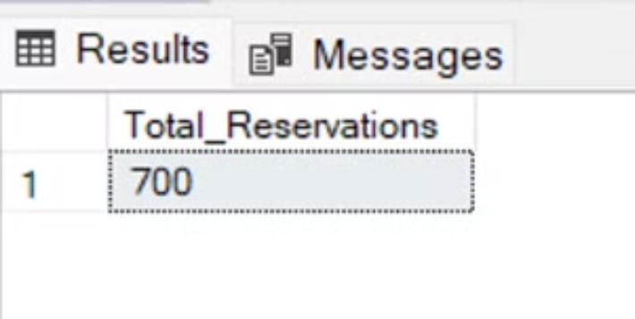
TASK
1. What is the total number of reservations in the dataset?
SELECT COUNT(*) AS total_reservations FROM reservations;

Slide 7

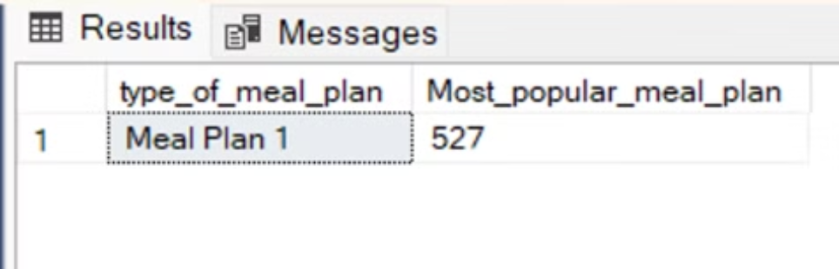
2. Which meal plan is the most popular among guests?
SELECT type_of_meal_plan, COUNT(*) AS Mst_popular_meal_plan From reservations GROUP BY type_of_meal_plan ORDER BY count(*) DESC;

Slide 8
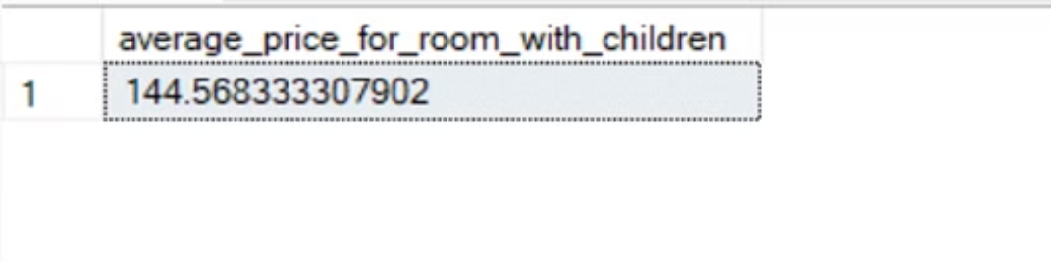
3. What is the average price per room for reservations involving children?
SELECT AVG(avg_price_per_room) AS average_price_for_room_with_children FROM reservations WHERE no_of_children > 0;

Slide 9

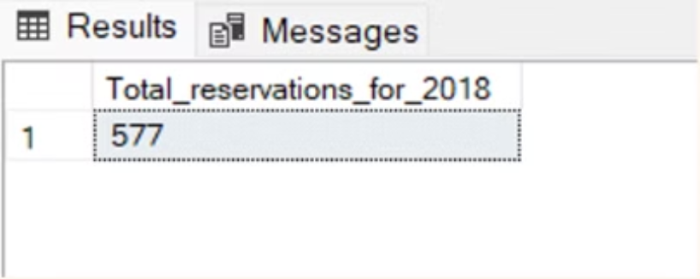
4. How many reservations were made for the year 2017
SELECT COUNT(*) AS total_reservations_for_2018 FROM reservations WHERE YEAR (arrival_date) = 2018;

Slide 10

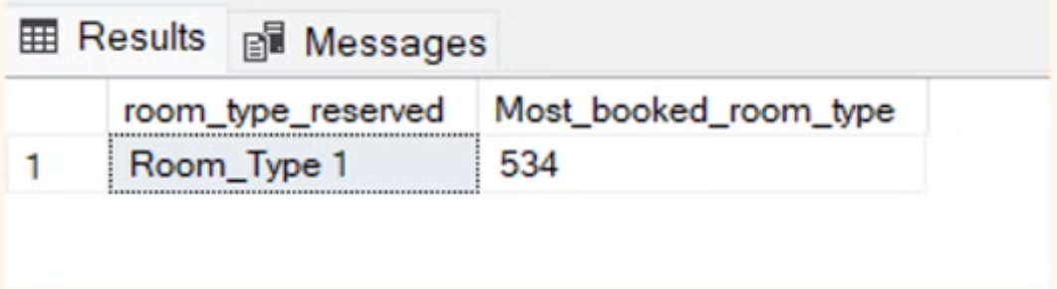
5. What is the most commonly booked room type?
SELECT Top 1 room_type_reserved, COUNT(*) AS Most_booked_room_type FROM reservations GROUP BY room_type_reserved ORDER BY count (*)DESC;

Slide 11

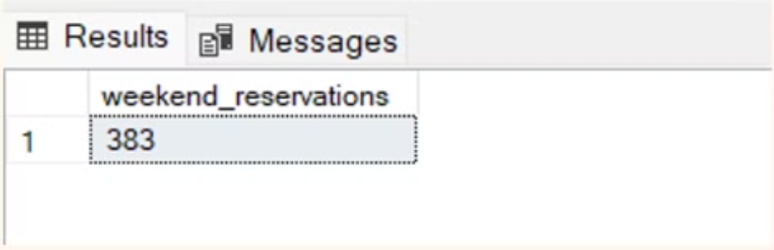
6. How many reservations fall on a weekend (no_of_weekend_nights > 0)?
SELECT COUNT(*) AS weekend_reservations FROM reservations WHERE no_of_weekend_nights > 0;

Slide 12

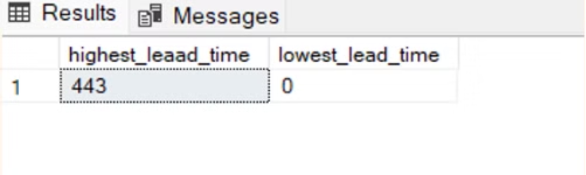
7. What is the highest and lowest lead time for reservations?
SELECT MAX(lead_time) AS highest_leaad_time, MIN(lead_time) AS lowest_lead_time FROM reservations;

Slide 13
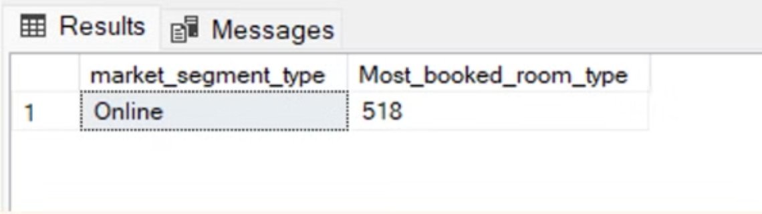
8. What is the most common market segment type for reservations?
SELECT market_segment_type, COUNT(*) AS Most_booked_room_type FROM reservations GROUP BY market_segment_type ORDER BY count DESC;

Slide 14
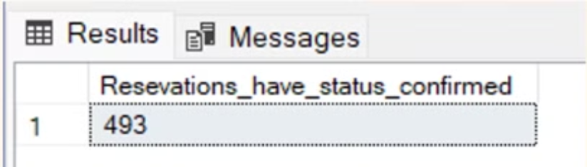
9. How many reservations have a booking status of "Confirmed"?
SELECT COUNT(*) AS Reservations_have_status_confirmed FROM reservations WHERE booking_status = 'Not_Canceled';

Slide 15
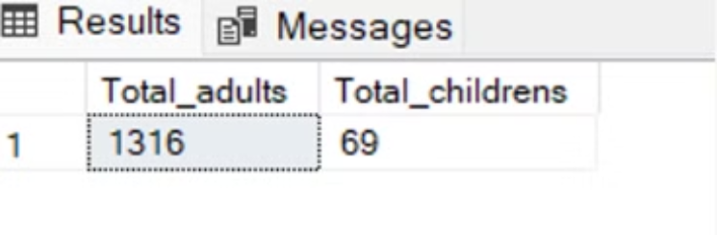
10. What is the total number of adults and children across all reservations?
SELECT SUM(no_of_adults) AS total_adults, SUM(no_of_children) AS total_children FROM reservations;

Slide 16
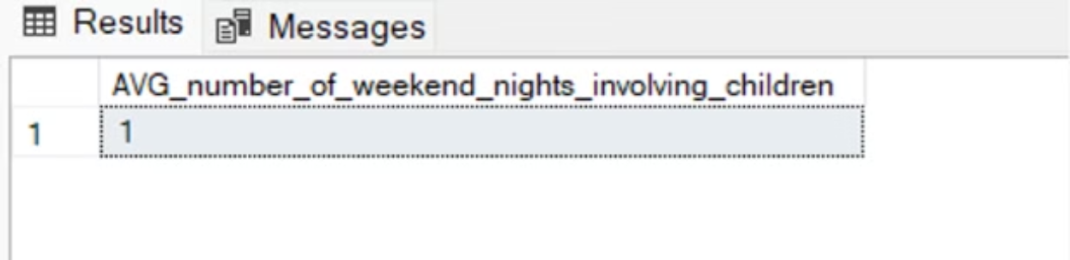
11. What is the average number of weekend nights for reservations involving children?
SELECT AVG(no_of_weekend_nights) AS AVG_number_of_weekend_nights_involving_children FROM reservations WHERE no_of_children > 0;

Slide 17

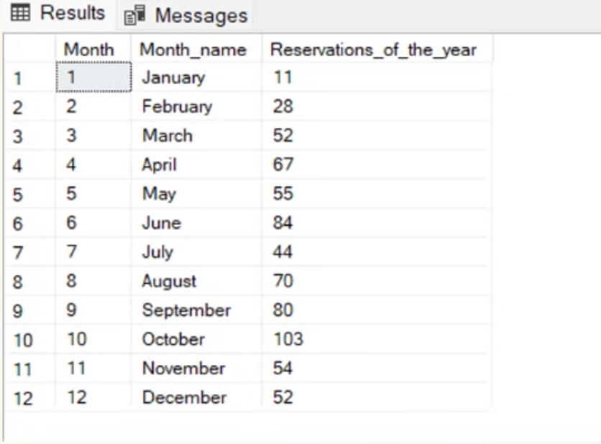
12. How many reservations were made in each month of the year?
SELECT MONTH(arrival_date) AS month,DATENAME(MONTH,arrival_date)As Month_name,count(*) AS reservations_of_the_year FROM reservations GROUP BY MONTH(arrival_date),DATENAME(MONTH,arrival_date) ORDER BY MONTH(arrival_date);

Slide 18

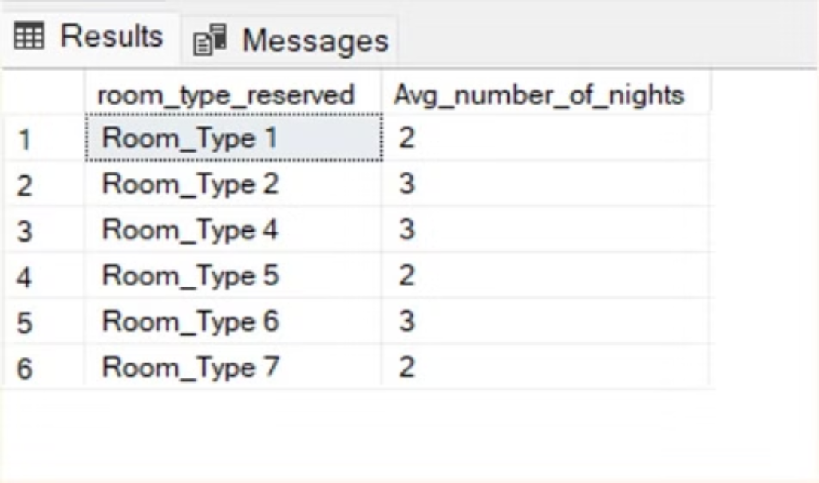
13. What is the average number of nights (both weekend and weekday) spent by guests for each room type?
SELECT room_type_reserved, AVG(no_of_weekend_nights + no_of_week_nights) AS avg_number_nights FROM reservations GROUP BY room_type_reserved ;

Slide 19
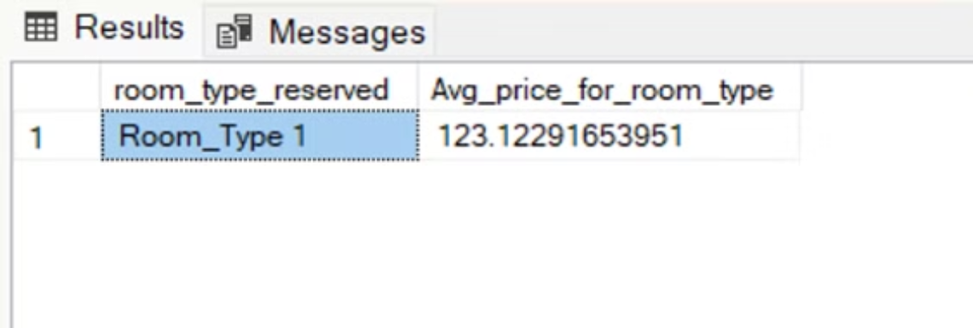
14. For reservations involving children, what is the most common room type, and what is the average price for that room type?
SELECT room_type_reserved, COUNT(*) AS count, AVG(avg_price_per_room) AS avg_price_for_room_type FROM reservations WHERE no_of_children > 0 GROUP BY room_type_reserved ORDER BY count DESC;

Slide 20
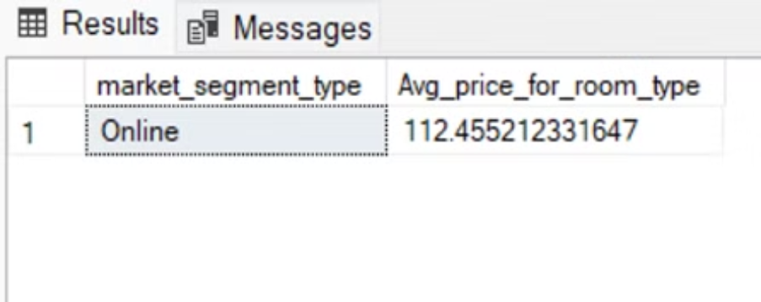
15. Find the market segment type that generates the highest average price per room.
SELECT market_segment_type, AVG(avg_price_per_room) AS avg_price_for_room_type FROM reservations GROUP BY market_segment_type ORDER BY average_price DESC;

Slide 21

Thank You !!

